Slide 1
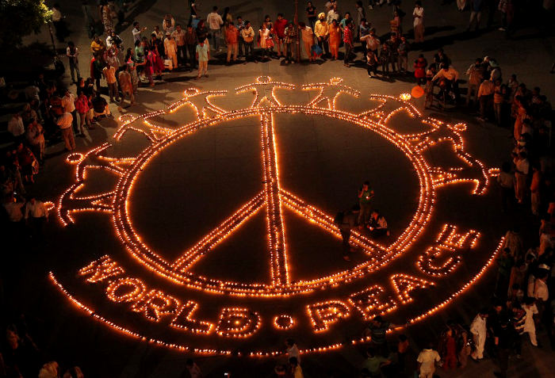
Happy Diwali
By: Shreya Deochand

Slide 2
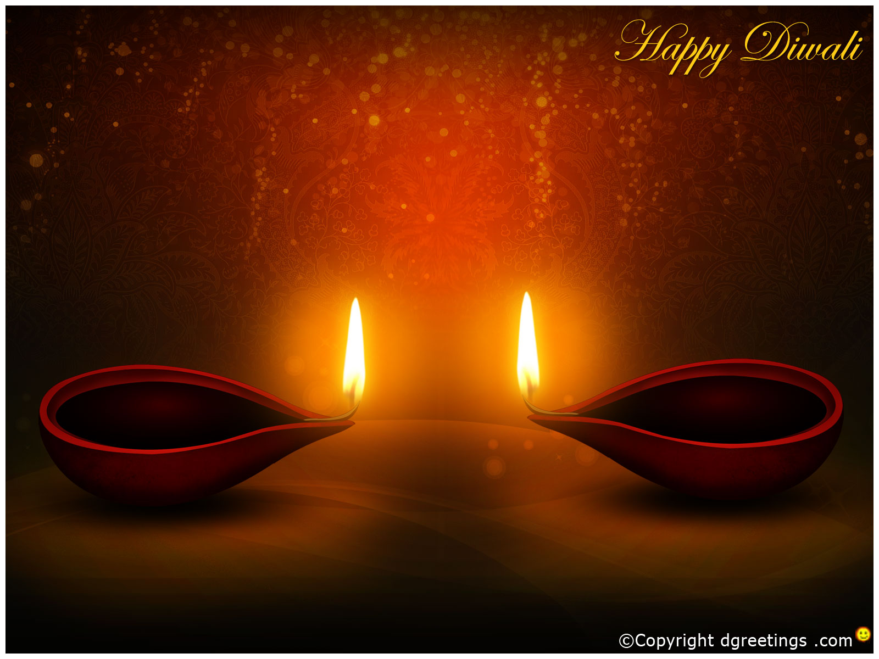
Enjoy the Video

Slide 3
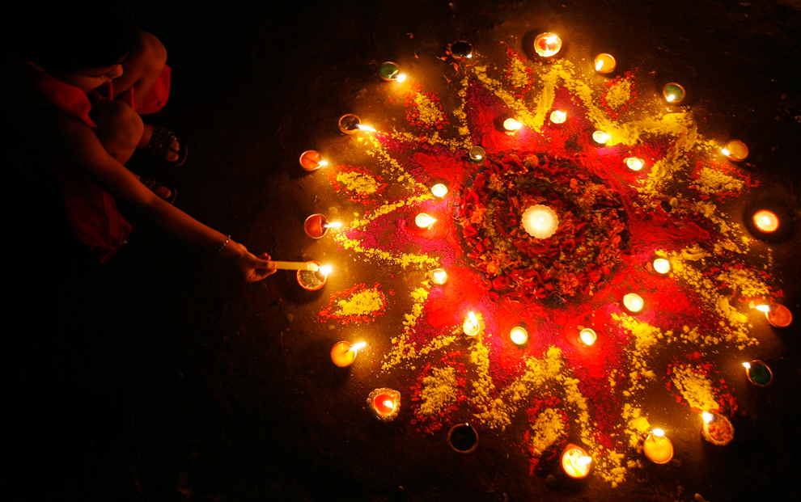
Thank You
I hope you liked learning more about my culture and about Diwali!
I would like to learn a lot about yours!

